Slide 1
Advanced Course
Cassandra

Slide 2
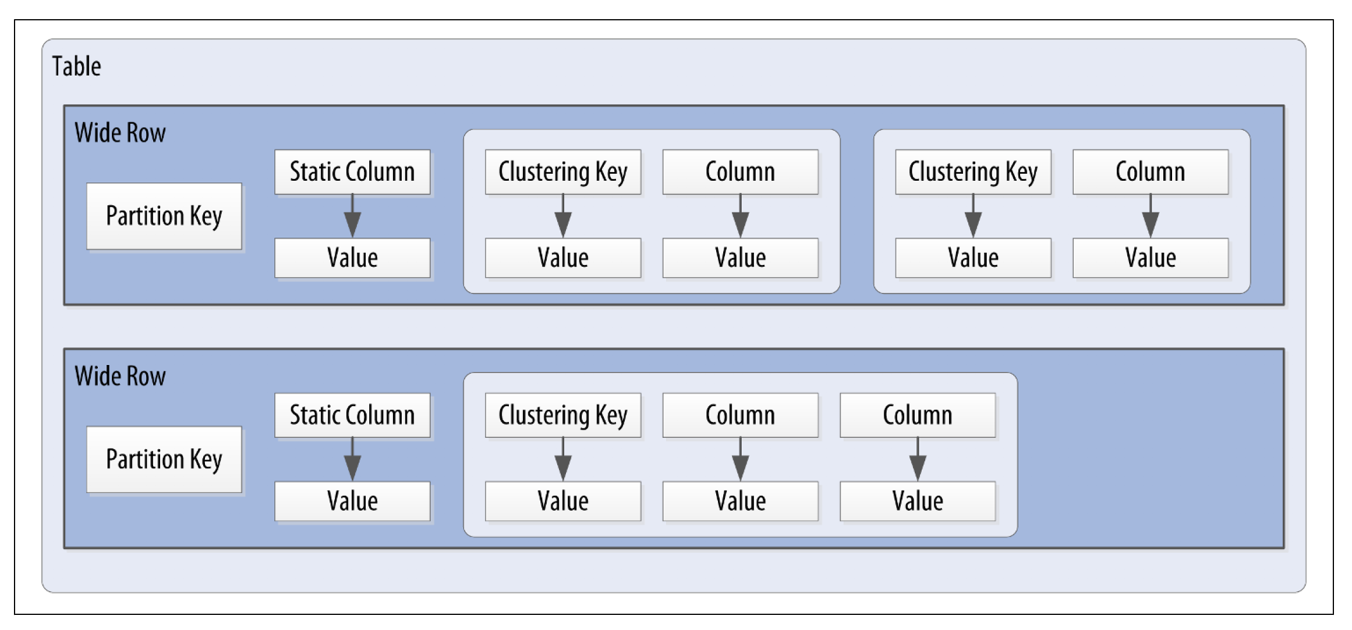
Cassandra’s Data Model

Slide 3
Secondary Indexes
If you try to query on column in a Cassandra table that is not part of the primary key, you’ll soon realize that this is not allowed. For example, consider our user table from which uses first_name as the primary key. Attempting to query by last_name results in the following output:
cqlsh:my_keyspace> SELECT * FROM user WHERE last_name = 'Nguyen';
InvalidRequest: code=2200 [Invalid query] message="No supported secondary index found for the non primary key columns restrictions"
As the error message instructs us, we need to create a secondary index for the last_name column. A secondary index is an index on a column that is not part of the primary key:
cqlsh:my_keyspace> CREATE INDEX ON user ( last_name );

Slide 4
Conceptual Data Modeling
For our example, we’ll use a domain that is easily understood and that everyone can relate to: making hotel reservations

Slide 5
Our conceptual domain includes hotels, guests that stay in the hotels, a collection of rooms for each hotel, the rates and availability of those rooms, and a record of reservations booked for guests. Hotels typically also maintain a collection of “points of interest,” which are parks, museums, shopping galleries, monuments, or other places near the hotel that guests might want to visit during their stay.
Both hotels and points of interest need to maintain geolocation data so that they can be found on maps for mashups, and to calculate distances.

Slide 6
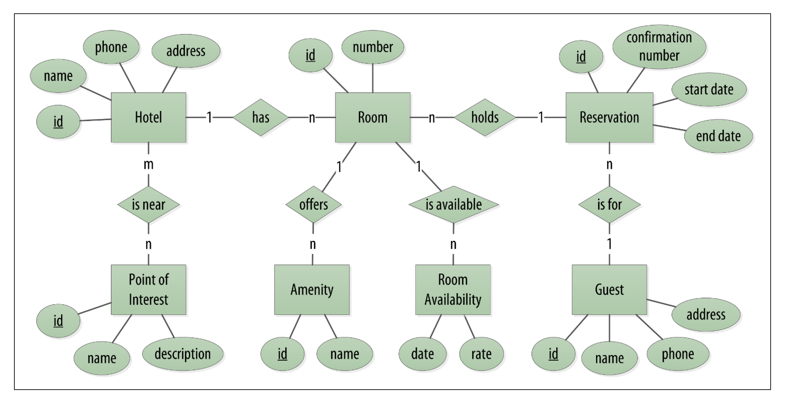
Hotel domain entity–relationship diagram

Slide 7
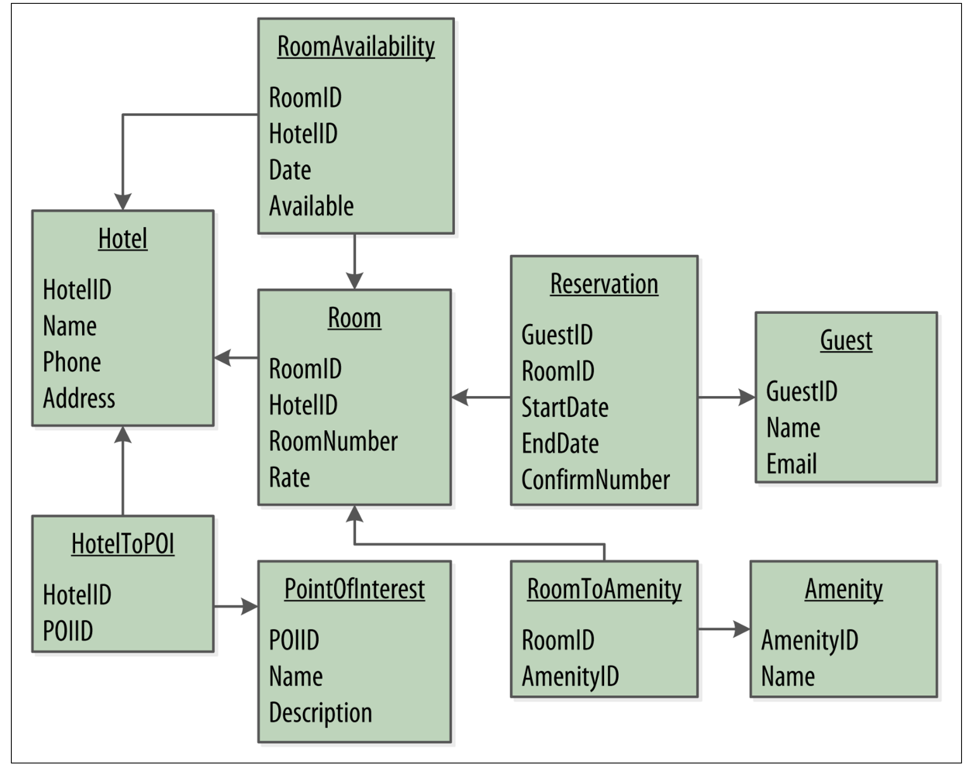
RDBMS Design

Slide 8
Design Differences Between RDBMS and Cassandra
No joins
No referential integrity
Denormalization
Query-first design
Designing for optimal storage
Sorting is a design decision

Slide 9
Defining Application Queries
Q1. Find hotels near a given point of interest.
Q2. Find information about a given hotel, such as its name and location.
Q3. Find points of interest near a given hotel.
Q4. Find an available room in a given date range.
Q5. Find the rate and amenities for a room.

Slide 10
Q6. Lookup a reservation by confirmation number.
Q7. Lookup a reservation by hotel, date, and guest name.
Q8. Lookup all reservations by guest name.
Q9. View guest details.

Slide 11
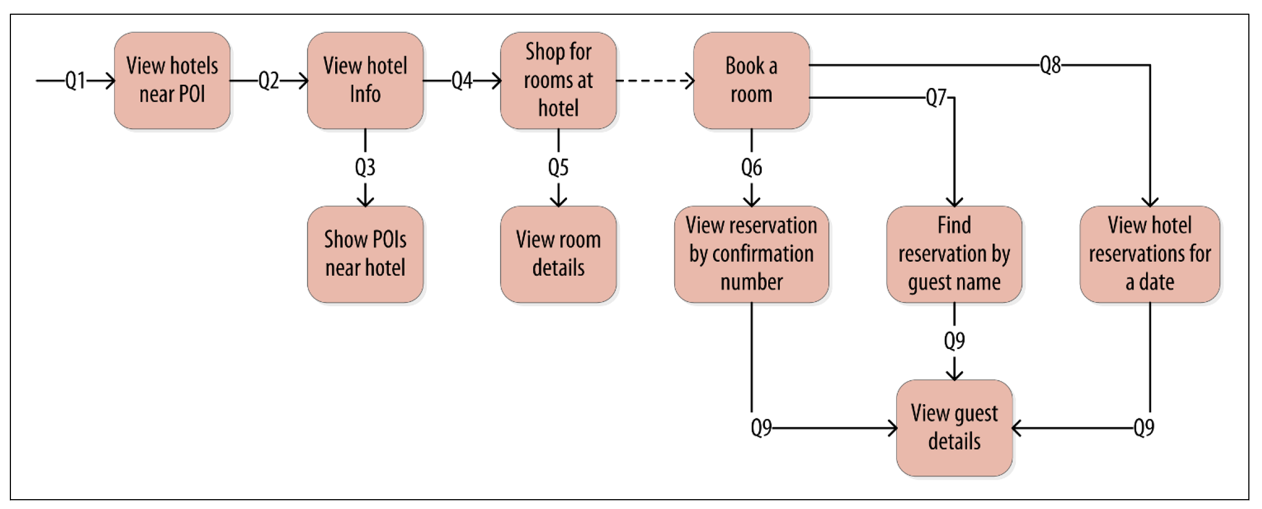
Hotel application queries

Slide 12
Logical Data Modeling
Now that we have defined our queries, we’re ready to begin designing our Cassandra tables. First, we’ll create a logical model containing a table for each query, capturing entities and relationships from the conceptual model.
To name each table, we’ll identify the primary entity type for which we are querying and use that to start the entity name. If we are querying by attributes of other related entities, we append those to the table name, separated with _by_. For example, hotels_by_poi.
Next, we identify the primary key for the table, adding partition key columns based on the required query attributes, and clustering columns in order to guarantee uniqueness and support desired sort ordering.

Slide 13
We complete each table by adding any additional attributes identified by the query. If any of these additional attributes are the same for every instance of the partition key, we mark the column as static.
Now that was a pretty quick description of a fairly involved process, so it will be worth our time to work through a detailed example. First, let’s introduce a notation that we can use to represent our logical models

Slide 14
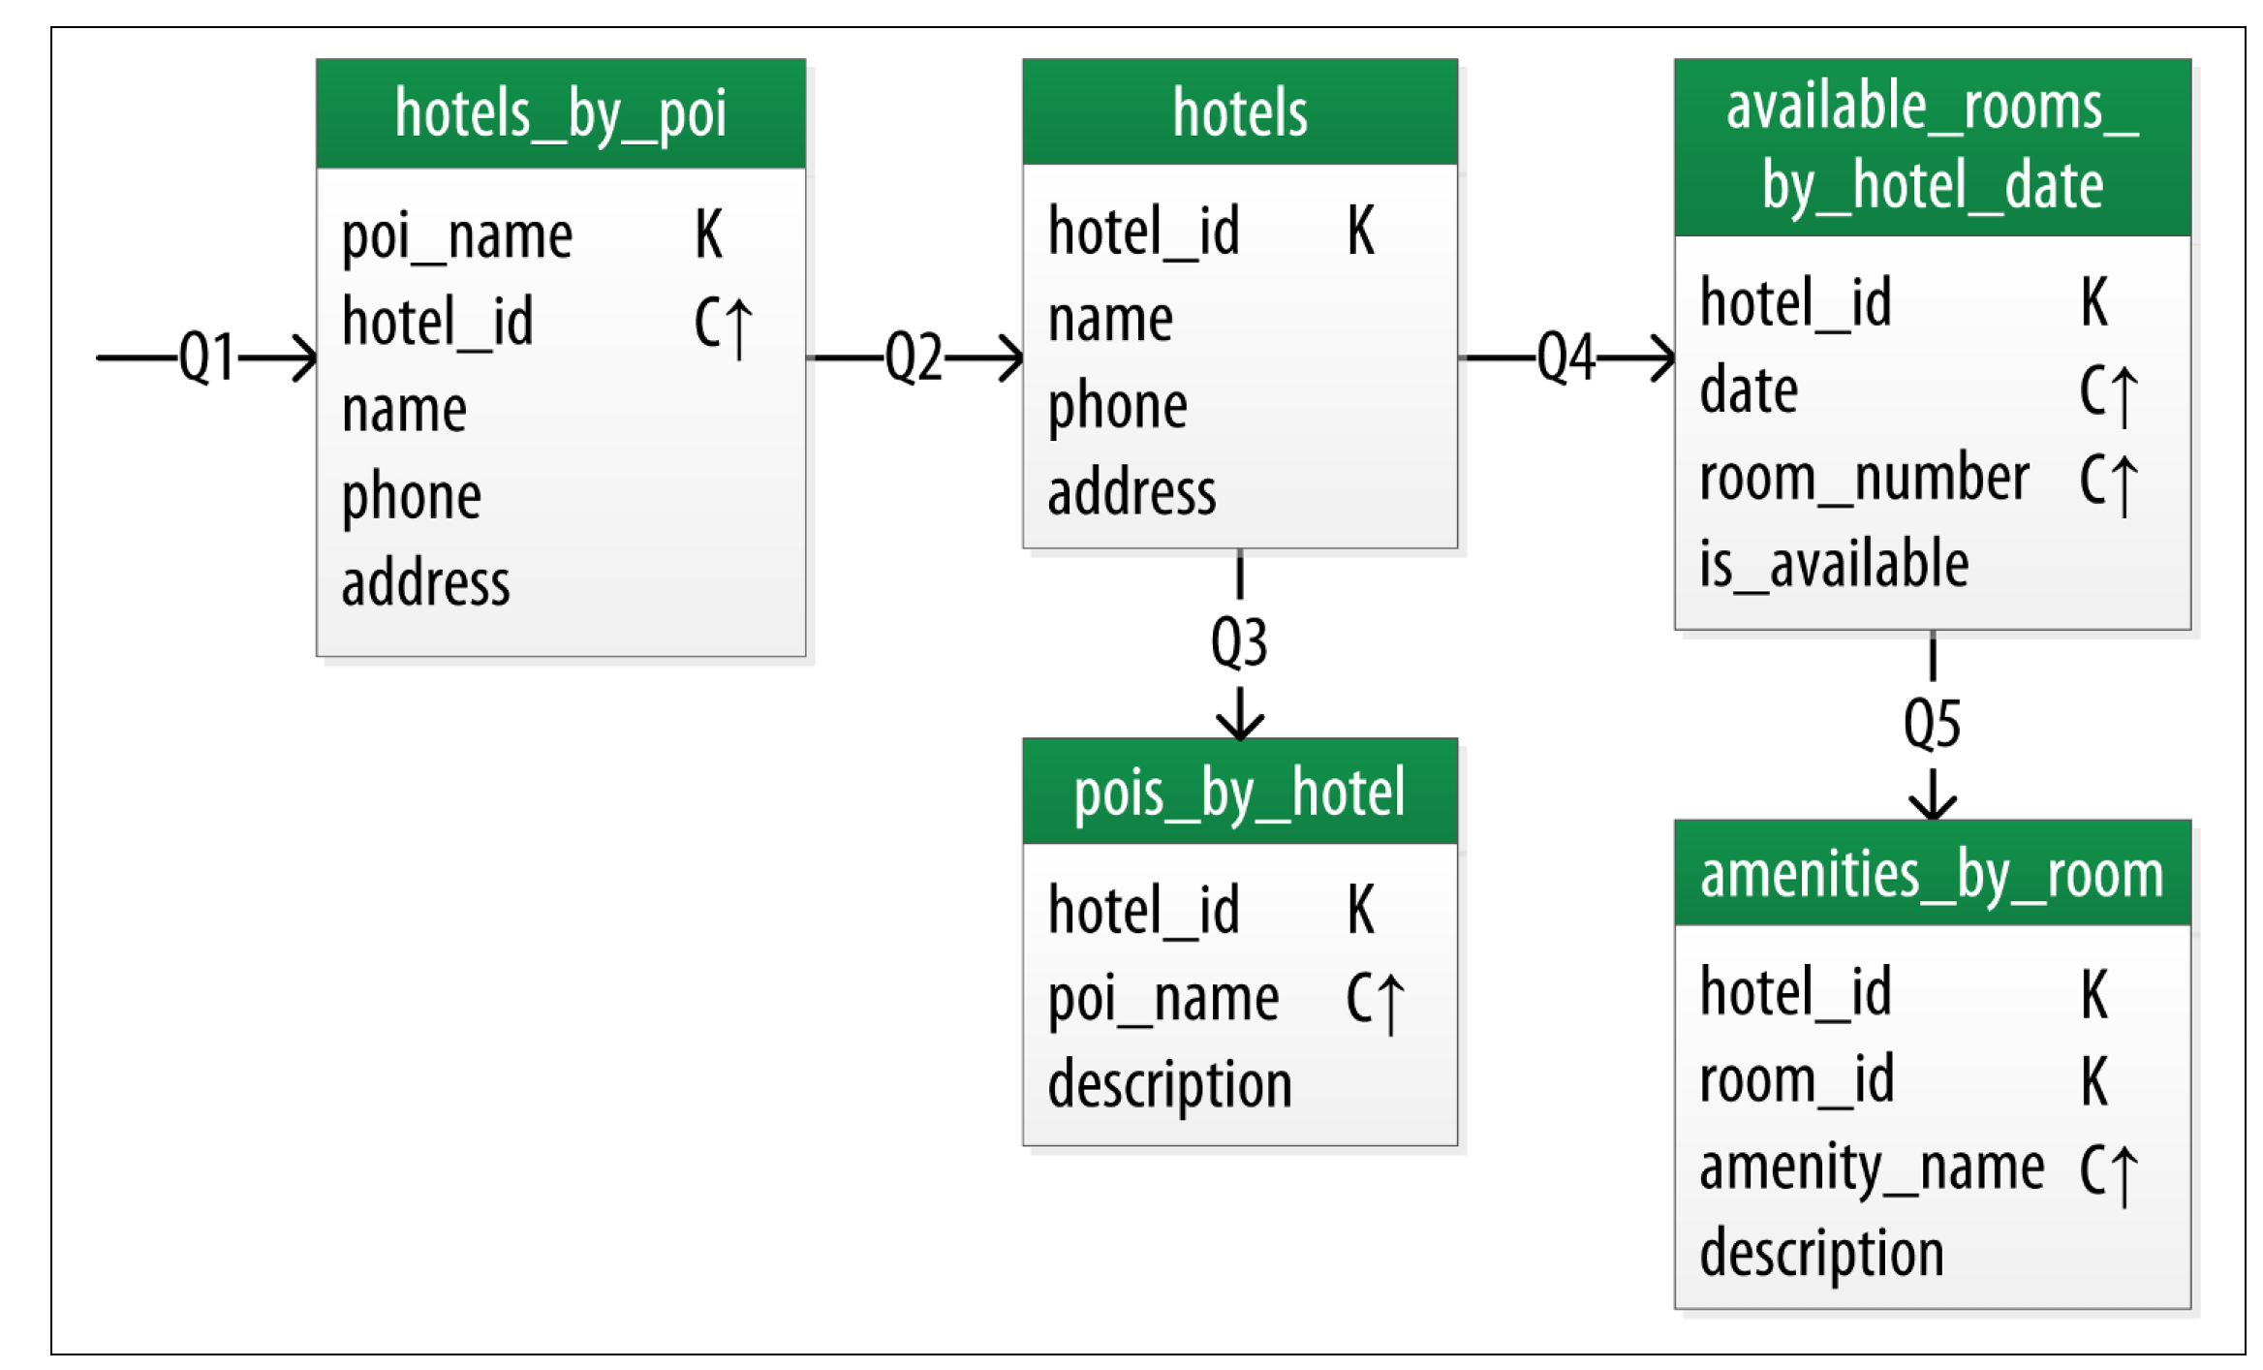
Hotel Chebotko Logical Data Model

Slide 15
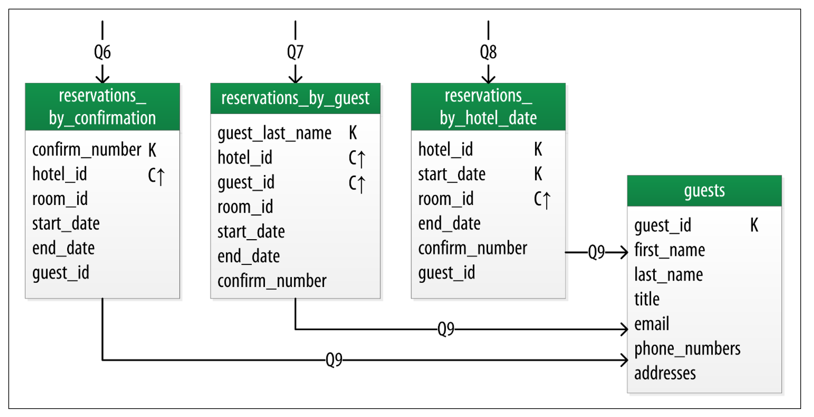
Reservation Logical Data Model

Slide 16
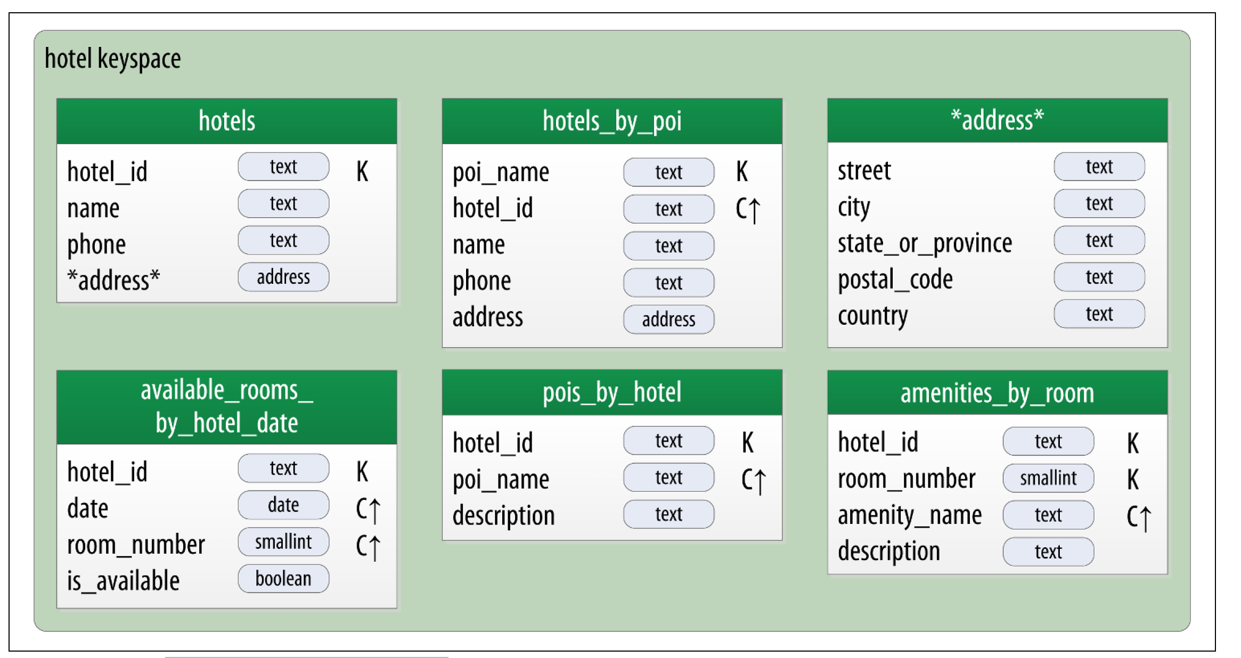
Hotel physical model

Slide 17
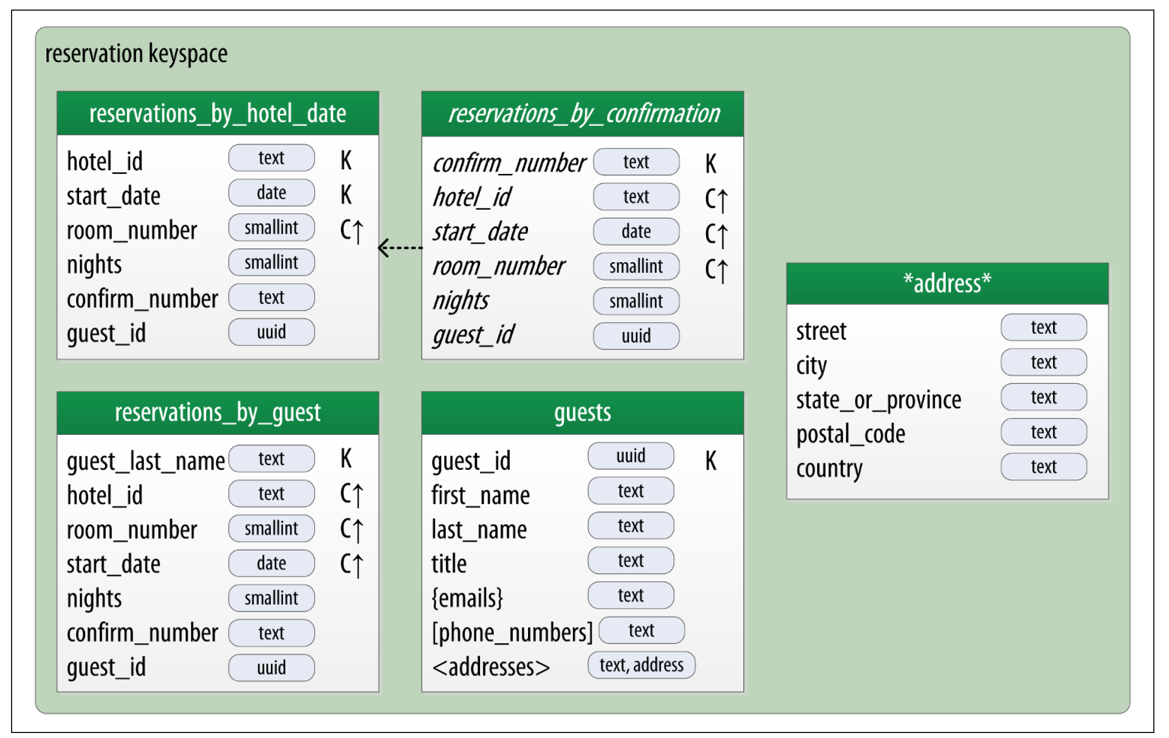
Reservation physical model

Slide 18
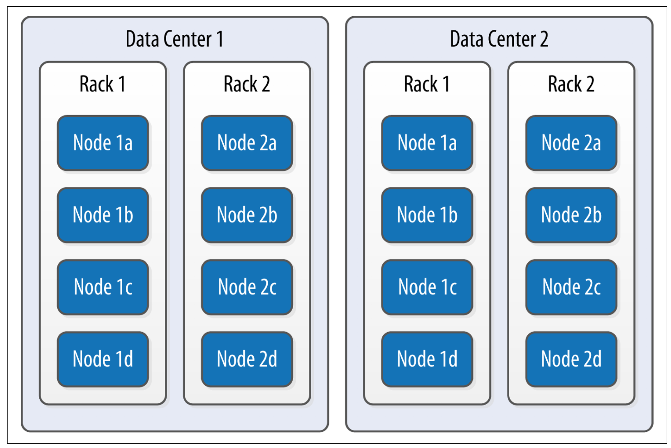
Data Centers and Racks

Slide 19
Gossip and Failure Detection
To support decentralization and partition tolerance, Cassandra uses a gossip protocol that allows each node to keep track of state information about the other nodes in the cluster. The gossiper runs every second on a timer.
The gossip protocol in Cassandra is primarily implemented by the org.apache.cassandra.gms.Gossiper class, which is responsible for managing gossip for the local node. When a server node is started, it registers itself with the gossiper to receive endpoint state information.

Slide 20
Here is how the gossiper works:
Once per second, the gossiper will choose a random node in the cluster and initialize a gossip session with it. Each round of gossip requires three messages
The gossip initiator sends its chosen friend a GossipDigestSynMessage
When the friend receives this message, it returns a GossipDigestAckMessage
When the initiator receives the ack message from the friend, it sends the friend a GossipDigestAck2Message to complete the round of gossip

Slide 21
Snitches
The job of a snitch is to determine relative host proximity for each node in a cluster, which is used to determine which nodes to read and write from.
Snitches gather information about your network topology so that Cassandra can efficiently route requests.
The snitch will figure out where nodes are in relation to other nodes

Slide 22
Simple Snitch
By default, Cassandra uses org.apache.cassandra.locator.SimpleSnitch. This snitch is not rack-aware which makes it unsuitable for multi-data center deployments.
If you choose to use this snitch, you should also use the SimpleStrategy replication strategy for your keyspaces

Slide 23
Property File Snitch
The org.apache.cassandra.locator.PropertyFileSnitch is what is known as a rack-aware snitch, meaning that it uses information you provide about the topology of your cluster in a standard Java key/value properties file called Cassandra-topology.properties

Slide 24
Dynamic Snitch
Cassandra wraps your selected snitch with a org.apache.cassandra.locator.DynamicEndpointSnitch in order to select the highest performing nodes for queries.
The dynamic_snitch_badness_threshold property defines a threshold for changing the preferred node. The default value of 0.1 means that the preferred node must perform 10% worse than the fastest node in order to be lose its status.
The dynamic snitch updates this status according to the dynamic_snitch_update_interval_in_ms property, and resets its calculations at the duration specified by the dynamic_snitch_reset_interval_in_ms property.
The reset interval should be a much longer interval than the update interval because it is a more expensive operation, but it does allow a node to regain its preferred status without having to demonstrate performance superior to the badness threshold

Slide 25
Partitioners
A partitioner determines how data is distributed across the nodes in the cluster
The default Partitioner is the MurMur3 Partitioner

Slide 26
Murmur3 Partitioner
The default partitioner is org.apache.cassandra.dht.Murmur3Partitioner. The Murmur3Partitioner uses the murmur hash algorithm to generate tokens. This has the advantage of spreading your keys evenly across your cluster, because the distribution is random.
It has the disadvantage of causing inefficient range queries, because keys within a specified range might be placed in a variety of disparate locations in the ring, and key range queries will return data in an essentially random order.
In general, new clusters should always use the Murmur3Partitioner. However, Cassandra provides several older partitioners for backward compatibility

Slide 27
Random Partitioner
The random partitioner is implemented by org.apache.cassandra.dht.RandomPartitioner and was Cassandra’s default in Cassandra 1.1 and earlier.
It uses a BigIntegerToken with an MD5 cryptographic hash applied to it to determine where to place the keys on the node ring.
Although the RandomPartitioner and Murmur3Partitioner are both based on random hash functions, the cryptographic hash used by RandomPartitioner is considerably slower, which is why the Murmur3Partitioner replaced it as the default

Slide 28
Order-Preserving & ByteOrderedPartitioner
The order-preserving partitioner is implemented by org.apache.cassandra.dht.OrderPreservingPartitioner.
Using this type of partitioner, the token is a UTF-8 string, based on a key. Rows are therefore stored by key order, aligning the physical structure of the data with your sort order. Configuring your column family to use order-preserving partitioning (OPP) allows you to perform range slices

Slide 29
It’s worth noting that OPP isn’t more efficient for range queries than random partitioning—it just provides ordering.
It has the disadvantage of creating a ring that is potentially very lopsided, because real-world data typically is not written to evenly. As an example, consider the value assigned to letters in a Scrabble game. Q and Z are rarely used, so they get a high value. With OPP, you’ll likely eventually end up with lots of data on some nodes and much less data on other nodes.
The nodes on which lots of data is stored, making the ring lopsided, are often referred to as hotspots.
Because of the ordering aspect, users are sometimes attracted to OPP. However, using OPP means in practice that your operations team needed to manually rebalance nodes more frequently using nodetool loadbalance or move operations. Because of these factors, usage of order preserving partitioners is discouraged. Instead, use indexes

Slide 30
ByteOrderedPartitioner
The ByteOrderedPartitioner is an order-preserving partitioner that treats the data as raw bytes, instead of converting them to strings the way the order-preserving partitioner and collating order-preserving partitioner do.
If you need an order-preserving partitioner that doesn’t validate your keys as being strings, BOP is recommended for the performance improvement

Slide 31
Replication Strategies
A node serves as a replica for different ranges of data. If one node goes down, other replicas can respond to queries for that range of data.
Cassandra replicates data across nodes in a manner transparent to the user, and the replication factor is the number of nodes in your cluster that will receive copies (replicas) of the same data.
If your replication factor is 3, then three nodes in the ring will have copies of each row

Slide 32
What Are Durable Writes?
The durable_writes property allows you to bypass writing to the commit log for the keyspace.
This value defaults to true, meaning that the commit log will be updated on modifications.
Setting the value to false increases the speed of writes, but also has the risk of losing data if the node goes down before the data is flushed from memtables into SSTables.

Slide 33
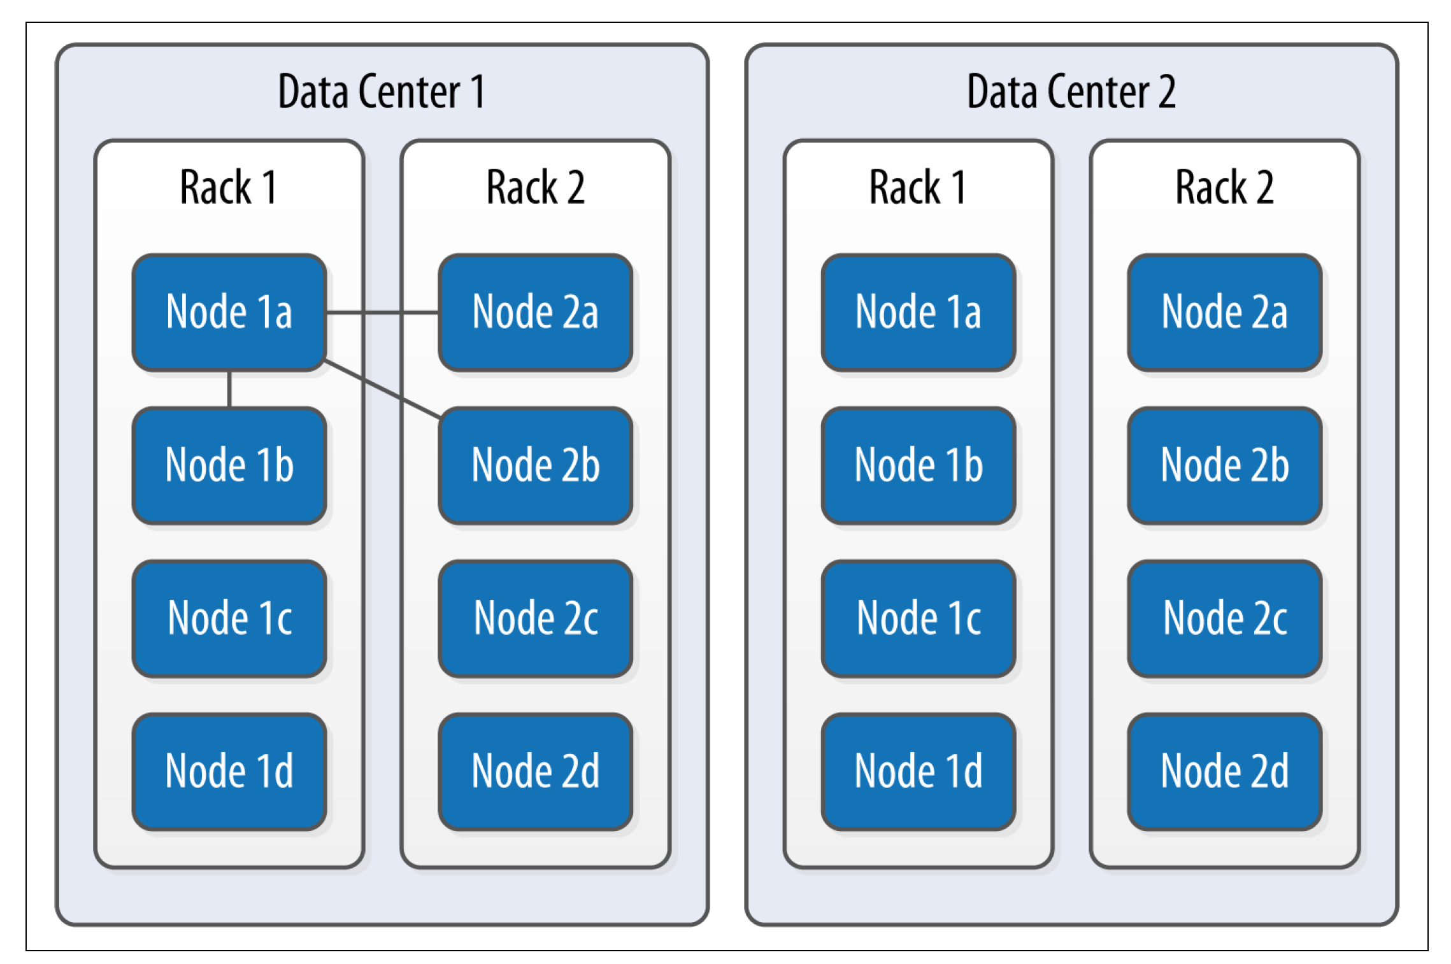
SimpleStrategy

Slide 34
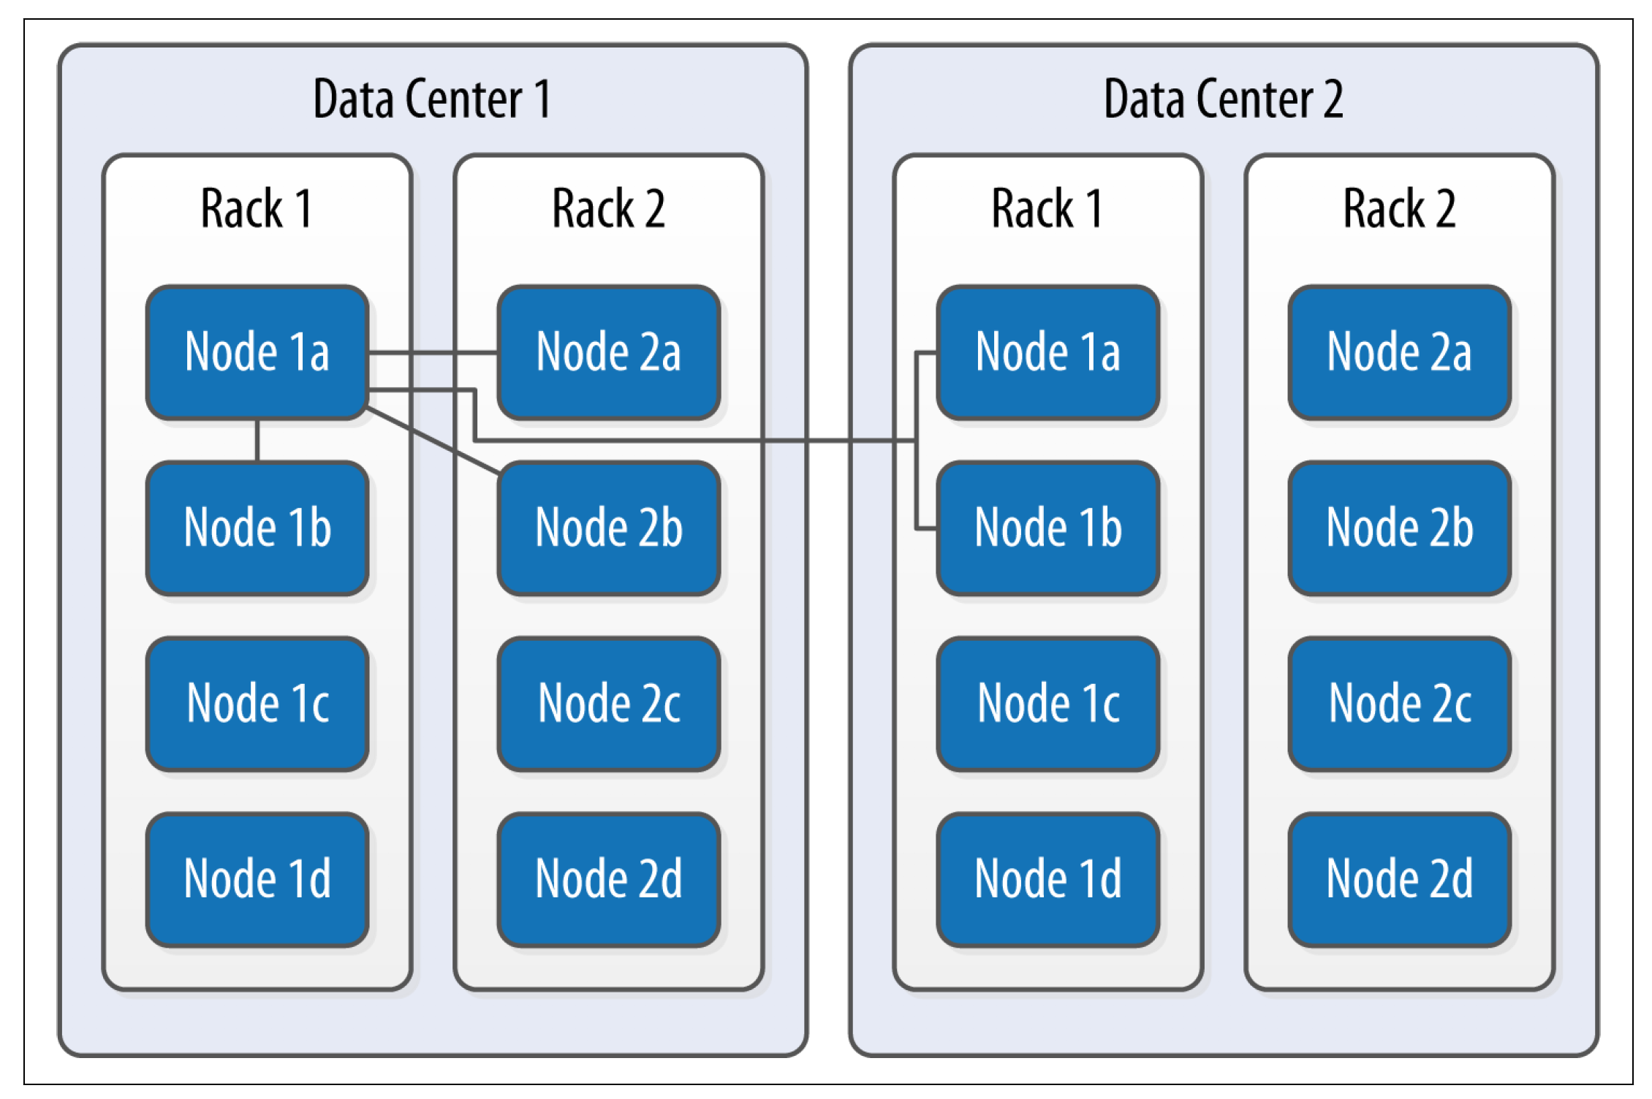
NetworkTopologyStrategy

Slide 35
Caching
Caches are used to improve responsiveness to read operations. Additional memory is used to hold data, to minimize the number of disk reads that must be performed.
As the cache size increases, so does the number of “hits” that can be served from memory.
There are three caches built into Cassandra: the key cache, row cache, and counter cache.

Slide 36
caching strategy
Consider your queries, and use the cache type that best fits your queries.
Consider the ratio of your heap size to your cache size, and do not allow the cache to overwhelm your heap.
Consider the size of your rows against the size of your keys. Typically keys will be much smaller than entire rows.

Slide 37
Key Cache
Cassandra’s key cache stores a map of partition keys to row index entries, facilitating faster read access into SSTables stored on disk.
We can configure usage of the key cache on a per-table basis.

Slide 38
Because the key cache greatly increases reads without consuming a lot of additional memory, it is enabled by default; that is, key caching is enabled if you don’t specify a value when creating the table. We can disable key caching for this table with the
ALTER TABLE command:
cqlsh:hotel> ALTER TABLE hotels WITH caching = { 'keys' : 'NONE', 'rows_per_partition' : 'NONE' };
The legal options for the keys attribute are ALL or NONE.

Slide 39
The key_cache_size_in_mb setting indicates the maximum amount of memory that will be devoted to the key cache, which is shared across all tables.
The default value is either 5% of the total JVM heap, or 100 MB, whichever is less

Slide 40
Row Cache
The row cache caches entire rows and can speed up read access for frequently
accessed rows, at the cost of more memory usage.
You’ll want to use the row cache size setting carefully, as this can easily lead to more performance issues than it solves. In many cases, a row cache can yield impressive performance results for small data sets when all the rows are in memory, only to degrade on larger data sets when the data must be read from disk.
If your table gets far more reads than writes, then configuring an overly large row cache will needlessly consume considerable server resources. If your table has a lower ratio of reads to writes, but has rows with lots of data in them (hundreds of columns), then you’ll need to do some math before setting the row cache size.

Slide 41
As with key caching, we can configure usage of the row cache on a per-table basis.
The rows_per_partition setting specifies the number of rows that will be cached per partition. By default, this value is set to NONE, meaning that no rows will be cached.
Other available options are positive integers or ALL. The following CQL statement sets the row cache to 200 rows:
cqlsh:hotel> ALTER TABLE hotels WITH caching = { 'keys' : 'NONE', 'rows_per_partition' : '200' };

